Slide 1
Data Science
CSE-4075
(Hypothesis Testing)

Slide 2
Hypothesis Testing
Statistical hypothesis testing is a framework for determining whether observed data deviates from what is expected.
It is also called significance testing
As data scientists, we’ll want to test whether a certain hypothesis is likely to be true, e.g.
This coin is fair.
Data scientists prefer Python to R.
Whether the average age of voters in your home state differs from the national average.

Slide 3
Hypothesis Testing Steps
Step 1. Develop the null and alternative hypotheses.
Step 2. Specify the level of significance α.
Step 3. Collect the sample data and compute the value of the test statistic.
p-Value Approach
Step 4. Use the value of the test statistic to compute the
p-value.
Step 5. Reject H₀ if p-value < α.
Critical Value Approach
Step 4. Use the level of significance to determine the critical value and the rejection rule.
Step 5. Use the value of the test statistic and the rejection rule to determine whether to reject H₀.

Slide 4
Null and Alternative Hypotheses
The null hypothesis, denoted by H₀ , is a tentative assumption about a population parameter.
The alternative hypothesis, denoted by H₁, is the opposite of what is stated in the null hypothesis.
The hypothesis testing procedure uses data from a sample to test the two competing statements indicated by H₀ and H₁.
Care must be taken to structure the hypotheses appropriately so that the test conclusion provides the information the data scientist wants.
The conclusion that the research hypothesis is true is made if the sample data provide sufficient evidence to show that the null hypothesis can be rejected.

Slide 5
Developing Null and Alternative Hypotheses
Alternative Hypothesis as a Research Hypothesis
Example:
A new teaching method is developed that is believed to be better than the current method.
Alternative Hypothesis:
The new teaching method is better.
Null Hypothesis:
The new method is no better than the old method.

Slide 6
Developing Null and Alternative Hypotheses
Alternative Hypothesis as a Research Hypothesis
Example:
A new drug is developed with the goal of lowering blood pressure more than the existing drug.
Alternative Hypothesis:
The new drug lowers blood pressure more than the existing drug.
Null Hypothesis:
The new drug does not lower blood pressure more than the existing drug.

Slide 7
Developing Null and Alternative Hypotheses
Null Hypothesis as an Assumption to be Challenged.
Example:
The label on a soft drink bottle states that it contains > 67.6 fluid ounces.
Alternative Hypothesis:
The label is incorrect. m < 67.6 ounces.
Null Hypothesis:
The label is correct. m > 67.6 ounces.

Slide 8
Type I Error
Because hypothesis tests are based on sample data, we must allow for the
possibility of errors.
A Type I error is rejecting H₀ when it is true.
The probability of making a Type I error when the null hypothesis is true as an
equality is called the level of significance.
Applications of hypothesis testing that only control the Type I error are often
called significance tests.

Slide 9
Type II Error
A Type II error is accepting H₀ when it is false.
It is difficult to control for the probability of making a Type II error.
Statisticians avoid the risk of making a Type II error by using “do not reject
H₀” and not “accept H₀”.

Slide 10
p-Value Approach to
One-Tailed Hypothesis Testing
The p-value is the probability, computed using the test statistic, that measures
the support (or lack of support) provided by the sample for the
null hypothesis.
If the p-value is less than or equal to the level of significance α, the value of
the test statistic is in the rejection region.
Reject H₀ if the p-value <= α .

Slide 11
Suggested Guidelines for Interpreting p-Values
Less than .01
Overwhelming evidence to conclude H₁ is true.
Between .01 and .05
Strong evidence to conclude H₁ is true.
Between .05 and .10
Weak evidence to conclude H₁ is true.
Greater than .10
Insufficient evidence to conclude H₁ is true

Slide 12
Lower-Tailed Test About a Population Mean: σ Known
p-Value Approach
p-Value < α ,
so reject H₀.
α = .10
Sampling
distribution
of
p-value
= .072
z
z =
-1.46
-z_{α} =
-1.28
0

Slide 13
Upper-Tailed Test About a Population Mean: σ Known
p-Value < α ,
so reject H₀.
p-Value Approach
Sampling
distribution
of
α = .04
p-Value
= .011
z
0
z_{α} =
1.75
z =
2.29

Slide 14
Critical Value Approach to One-Tailed Hypothesis Testing
The test statistic z has a standard normal probability distribution.
We can use the standard normal probability distribution table to find the z-value with an area of α in the lower (or upper) tail of the distribution.
The value of the test statistic that established the boundary of the rejection region is called the critical value for the test.
The rejection rule is:
Lower tail: Reject H₀ if z < -z_{α}
Upper tail: Reject H₀ if z > z_{α}

Slide 15
Lower-Tailed Test About a Population Mean: σ Known
Critical Value Approach
Sampling
distribution
of
Reject H₀
α = .10
Do Not Reject H₀
z
−z_{α} = −1.28
0

Slide 16
Upper-Tailed Test About a Population Mean: σ Known
Critical Value Approach
Sampling
distribution
of
Reject H₀
α = .05
Do Not Reject H₀
z
0
z_{α} = 1.645

Slide 17
One-Tailed Tests About a Population Mean: σ
Known
Example: Metro EMS
The response times for a random sample of 40 medical emergencies were tabulated. The sample mean is 13.25 minutes. The population standard deviation is believed to be 3.2 minutes.
The EMS director wants to perform a hypothesis test, with a =.05 level of significance, to determine whether the service goal of 12 minutes or less is being achieved.

Slide 18
One-Tailed Tests About a Population Mean: σ
Known
p-value and critical value approaches
1. Develop the hypotheses.
H₀: μ < 12
H_{a}: μ > 12
2. Specify the level of significance.
α = .05
3. Compute the value of the test statistic.

Slide 19
One-Tailed Tests About a Population Mean: σ
Known
p-value approach
4. Compute the p –value.
For z = 2.47, cumulative probability = .9932.
p–value = 1 - .9932 = .0068
5. Determine whether to reject H₀.
Because p–value = .0068 < α = .05, we reject H₀.
There is sufficient statistical evidence to infer that Metro EMS is not meeting the response goal of 12 minutes.

Slide 20
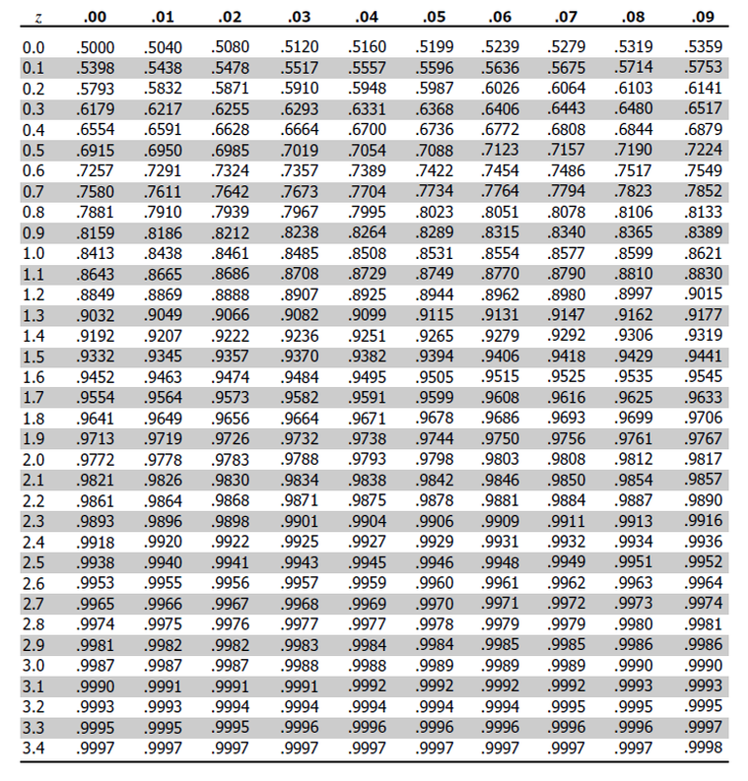

Slide 21
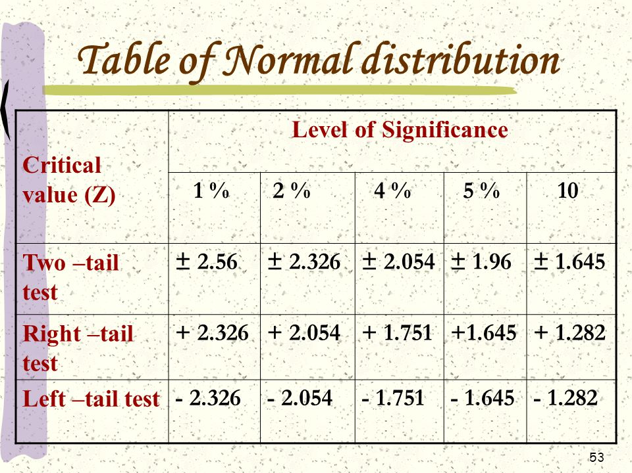

Slide 22
One-Tailed Tests About a Population Mean: σ
Known
p-value approach
Sampling
distribution
of
α = .05
p-value
= .0068
z
0
z_{α} =1.645
z =2.47

Slide 23
One-Tailed Tests About a Population Mean: σ
Known
Critical value approach
4. Determine the critical value and rejection rule.
For α = .05, z_{.05} = 1.645
Reject H₀ if z > 1.645
5. Determine whether to reject H₀.
Because 2.47 > 1.645, we reject H₀.
There is sufficient statistical evidence to infer that Metro EMS is not meeting the response goal of 12 minutes.

Slide 24
Two-Tailed Tests About a Population Mean: σ
Known
Example: Glow Toothpaste
The production line for Glow toothpaste is designed to fill tubes with a mean weight of 6 oz. Periodically, a sample of 30 tubes will be selected in
order to check the filling process.
Quality assurance procedures call for the continuation of the filling process if the sample results are consistent with the assumption that the mean filling weight for the population of toothpaste tubes is 6 oz.; otherwise the process will be adjusted.

Slide 25
Two-Tailed Tests About a Population Mean: σ
Known
Example: Glow Toothpaste
Assume that a sample of 30 toothpaste tubes provides a sample mean of 6.1 oz. The population standard deviation is believed to be 0.2 oz.
Perform a hypothesis test, at the .03 level of significance, to help determine whether the filling process should continue operating or be stopped and corrected.

Slide 26
Two-Tailed Tests About a Population Mean: σ
Known
p-value and critical value approaches
1. Determine the hypotheses.
H₀: μ = 6
H_{a}:
2. Specify the level of significance.
α = .03
3. Compute the value of the test statistic.

Slide 27
Two-Tailed Tests About a Population Mean: σ
Known
p-value approach
4. Compute the p –value.
For z = 2.74, cumulative probability = .9969
p–value = 2(1 - .9969) = .0062
5. Determine whether to reject H₀.
Because p–value = .0062 < α = .03, we reject H₀.
There is sufficient statistical evidence to infer that the alternative hypothesis is true (i.e. the mean filling weight is not 6 ounces).

Slide 28
Two-Tailed Tests About a Population Mean: σ
Known
p-value approach
1/2
p -value
= .0031
1/2
p -value
= .0031
α/2 =
.015
α/2 =
.015
z
z = -2.74
0
z = 2.74
-z_{α/2} = -2.17
z_{α/2} = 2.17

Slide 29
Two-Tailed Tests About a Population Mean: σ
Known
Critical value approach
4. Determine the critical value and rejection rule.
For α/2 = .03/2 = .015, z_{.015} = 2.17
Reject H0 if z < -2.17 or z > 2.17
5. Determine whether to reject H₀.
Because 2.74 > 2.17, we reject H₀.
There is sufficient statistical evidence to infer that the alternative hypothesis is true (i.e. the mean filling weight is not 6 ounces).

Slide 30
Two-Tailed Tests About a Population Mean: σ
Known
Critical value approach
Sampling
distribution
of
Reject H₀
Do Not Reject H₀
Reject H₀
α/2 = .015
α/2 = .015
z
-2.17
0
2.17

